Slide 1
What’s New in C#8
Jason Bock
Practice Lead

Slide 2
Personal Info
http://www.magenic.com
http://www.jasonbock.net
https://www.twitter.com/jasonbock
https://www.github.com/jasonbock
jasonb@magenic.com

Slide 3
Downloads
https://github.com/JasonBock/WhatsNewInCSharp8
https://github.com/JasonBock/Presentations

Slide 4
Overview
Language Evolution
C#8 Features
Future Directions
Remember…
https://github.com/JasonBock/WhatsNewInCSharp8
https://github.com/JasonBock/Presentations

Slide 5
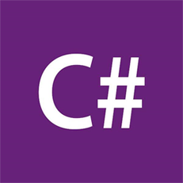
Language Evolution
Est. 2002
http://wilsonwong.me/images/logos/csharplogo.png
Notes:
It’s hard to believe that C# has been around since 2002. Along the way it’s picked up a fair amount of features.

Slide 6
Language Evolution
Version 1
Classes
Structs
Interfaces
Events
Properties
Delegates
Expressions
Statements
Attributes
Literals
https://github.com/dotnet/csharplang/blob/master/Language-Version-History.md#c-10-visual-studionet
Notes:
Version 1 had some “standard” language features that one would arguably expect from an OOP language.

Slide 7
Language Evolution
Version 2
Generics
Partial types
Anonymous methods
Iterators
Nullable types
Getter/setter separate accessibility
Method group conversions (delegates)
Co- and Contra-variance for delegates and interfaces
Static classes
Delegate inference
https://github.com/dotnet/csharplang/blob/master/Language-Version-History.md#c-2-vs-2005
Notes:
Version 2’s biggest addition was generics. That alone made coding easier to write, especially when it came to collections.

Slide 8
Language Evolution
Version 3
Implicitly typed local variables
Object and collection initializers
Auto-Implemented properties
Anonymous types
Extension methods
Query expressions
Lambda expression
Expression trees
Partial methods
https://github.com/dotnet/csharplang/blob/master/Language-Version-History.md#c-3-vs-2008
Notes:
LINQ was the biggest addition for C#3. With it came a whole slew of features to support it.

Slide 9
Language Evolution
Version 4
Dynamic binding
Named and optional arguments
Generic co- and contravariance
Embedded interop types ("NoPIA")
https://github.com/dotnet/csharplang/blob/master/Language-Version-History.md#c-4-vs-2010
Notes:
Verison 4 added some “interesting” features, with dynamic opening the door to C# being a little less type-safe.

Slide 10
Language Evolution
Version 5
Asynchronous methods
Caller info attributes
https://github.com/dotnet/csharplang/blob/master/Language-Version-History.md#c-5-vs-2012
Notes:
Version 5’s biggest (and maybe only) feature is async/await, making asynchronous/concurrent programming easier.

Slide 11
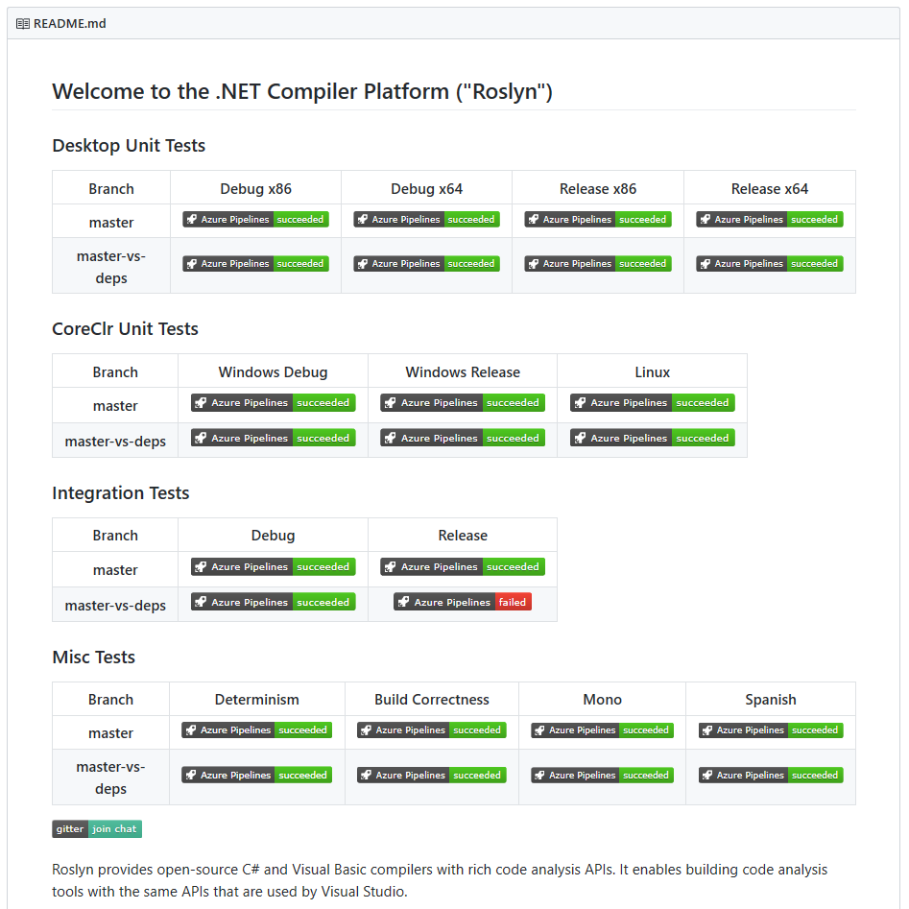
Language Evolution
Roslyn provides open-source C# and Visual Basic compilers with rich code analysis APIs. It enables building code analysis tools with the same APIs that are used by Visual Studio.
https://github.com/dotnet/roslyn
Notes:
The language space is open source. You can download the source code to the compilers and hack away (and submit pull requests if you’d like). You can watch as the language teams discuss current and potentially future changes. This is completely unlike the .NET of 2002.

Slide 12
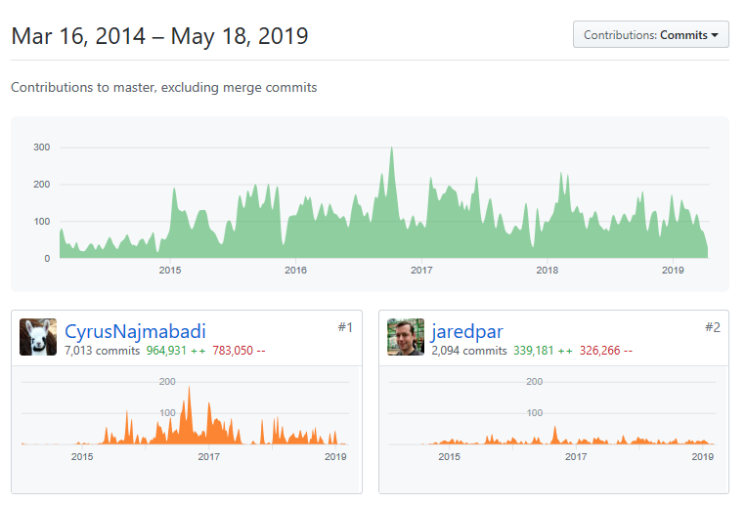
Language Evolution
https://github.com/dotnet/roslyn/graphs/contributors
Notes:
You can see who has contributed to Roslyn.

Slide 13
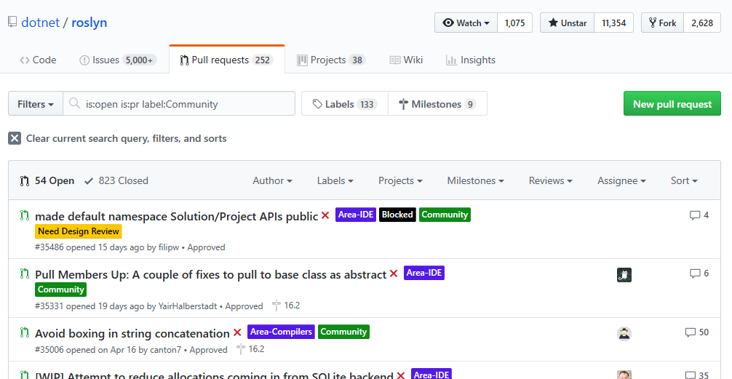

Language Evolution
https://github.com/dotnet/roslyn/pulls?q=is%3Aopen+is%3Apr+label%3ACommunity
Notes:
There’s a “Community” tag so you can see which PRs have been tagged with that.

Slide 14
Language Evolution
Version 6
Compiler-as-a-service (Roslyn)
Import of static type members into namespace
Exception filters
Await in catch/finally blocks
Auto property initializers
Default values for getter-only properties
Expression-bodied members
Null propagator (null-conditional operator, succinct null checking)
String interpolation
nameof operator
Dictionary initializer
https://github.com/dotnet/csharplang/blob/master/Language-Version-History.md#c-6-vs-2015
Notes:
With Version 6, there’s a lot of small, yet useful, features. And it’s interesting to note that a fair amount of these (like string interpolation) went through a lot of changes before it reached its final destination. Some features, like primary constructors, have been dropped for now (though they may come back in a future version). All this work was driven a lot by the community and what really worked best.

Slide 15
Language Evolution
Version 7
Out variables
Pattern matching
Tuples
Deconstruction
Discards
Local Functions
Binary Literals
Digit Separators
Ref returns and locals
Generalized async return types
More expression-bodied members
Throw expressions
https://github.com/dotnet/csharplang/blob/master/Language-Version-History.md#c-70-visual-studio-2017
Notes:
C#7 has continued the trend from C#6, with lots of small, yet useful features.

Slide 16
Language Evolution
Version 7.1
Async main
Default expressions
Reference assemblies
Inferred tuple element names
Pattern-matching with generics
https://github.com/dotnet/csharplang/blob/master/Language-Version-History.md#c-71-visual-studio-2017-version-153
Notes:
But C#7 has bucked a trend by introducing point releases. C#7.1 was released with the VS2017 15.3 release, and we’ll cover those as well in this talk

Slide 17
Language Evolution
Version 7.2
Ref readonly
Interior pointer/Span/ref struct
Non-trailing named arguments
private protected
Conditional ref operator
Digit separator after base specifier
https://github.com/dotnet/roslyn/blob/master/docs/Language%20Feature%20Status.md#c-72
Notes:
7.2 continued the point trend.

Slide 18
Language Evolution
Version 7.3
Enum, delegate, and unmanaged constraints
Ref local re-assignment
Stackalloc initializers
Indexing movable fixed buffers
Custom fixed statement
Improved overload candidates
Expression variables in initializers and queries
Tuple comparison
Attributes on backing fields
https://github.com/dotnet/csharplang/blob/master/Language-Version-History.md#c-73-visual-studio-2017-version-157
Notes:
And now we have 7.3 with VS2017 15.7.

Slide 19
Language Evolution
Version 8
Default Interface Methods
Nullable reference type
Recursive patterns
Async streams
Enhanced using
Ranges
Null-coalescing Assignment
Alternative interpolated verbatim strings
stackalloc in nested contexts
Unmanaged generic structs
Static local functions
Readonly members
https://github.com/dotnet/roslyn/blob/master/docs/Language%20Feature%20Status.md
Notes:
And now we have 8.0

Slide 20
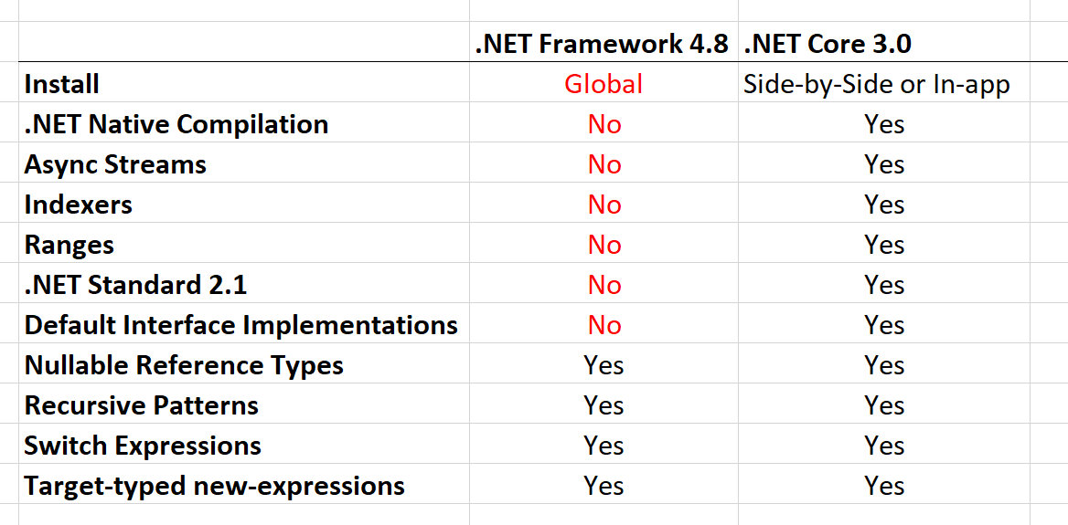
Language Evolution
https://twitter.com/dotMorten/status/1105343335164596224?s=09
Notes:
Note that C#8 won’t fully work in .NET Framework 4.8

Slide 21
Demo: C#8 Features
What’s New in C#8

Slide 22

Future Directions
https://dialectline.files.wordpress.com/2012/04/crystal_ball1.jpg
Notes:
So, where will C# go from here? As with any crystal ball gazing, sometimes the best we can do is guess. But with C# being OSS, it’s easier to see the roadmap, so let’s talk about some of the features that may show up in the future.

Slide 23
Future Directions
Source generators
Records
Roles, extension interfaces, and static interface members
Notes:
These may get in some future version of C#, or not, we don’t know yet.
References:
Source generators - https://github.com/dotnet/roslyn/blob/master/docs/features/generators.md
Records - https://github.com/dotnet/roslyn/blob/master/docs/features/records.md
Roles, extension interfaces, and static interface members - https://github.com/dotnet/csharplang/issues/1711

Slide 24
Future Directions – Source Generators
// original.cs:
partial class C
{
void F() { }
int P { get; set; }
object this[int index] { get { return null; } }
event EventHandler E;
}

Slide 25
Future Directions – Source Generators
// replace.cs:
partial class C
{
replace void F() { original(); }
replace int P
{
get { return original; }
set { original += value; } // P.get and P.set
}
replace object this[int index]
{
get { return original[index]; }
}
replace event EventHandler E
{
add { original += value; }
remove { original -= value; }
}
}

Slide 26
Future Directions – Records
public record Point(int X, int Y);
var point = new Point(3, 4);
var newPoint = point with { X = 5 };

Slide 27
Future Directions – Roles and Extensions
public interface IMonoid<T> where T : IMonoid<T>
{
static T operator +(T t1, T t2);
static T Zero { get; }
}

Slide 28
Future Directions – Roles and Extensions
public T AddAll<T>(T[] values) where T : IMonoid<T>
{
T result = T.Zero;
foreach (T value in values) { result += value; }
return result;
}

Slide 29
Future Directions – Roles and Extensions
public extension IntMonoid of int : IMonoid<int>
{
public static int Zero => 0;
}
int result = AddAll(
new int[] { 1, 2, 3, 4, 5, 6, 7, 8, 9 });

Slide 30
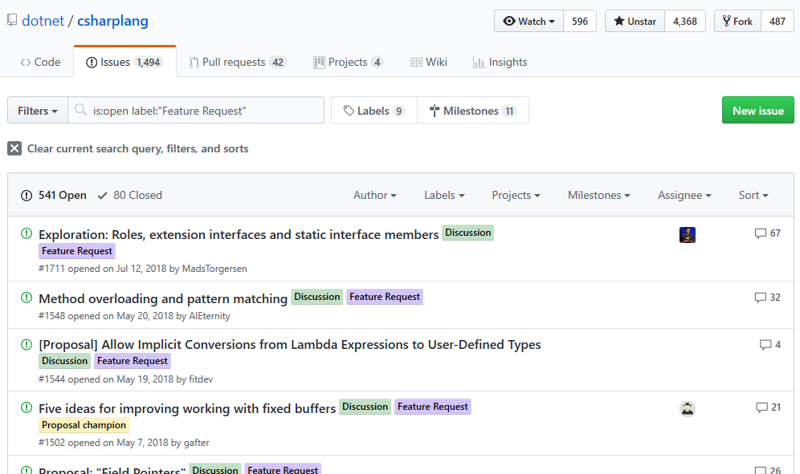
Future Directions
https://github.com/dotnet/csharplang/labels/Feature%20Request
Notes:
If you have an idea, submit a feature request and see where it goes.

Slide 31
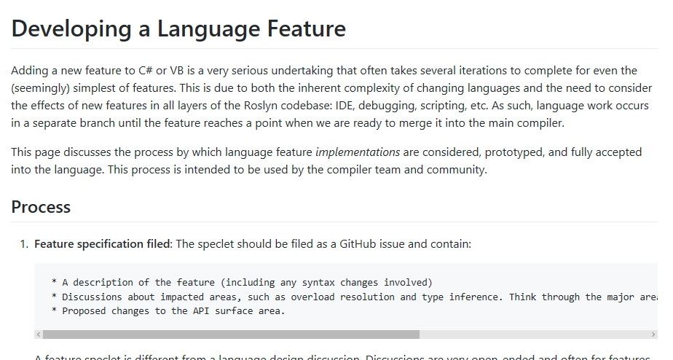
Future Directions
https://github.com/dotnet/roslyn/blob/master/docs/contributing/Developing%20a%20Language%20Feature.md
Notes:
Just follow the directions….also, keep in mind that if your idea will touch overloading in any way, the review process gets really complicated.

Slide 32

Future Directions
More expression-bodied members
http://www.wildfiresparks.co.uk/wp-content/uploads/2014/02/Influence.png
Notes:
YOU can influence the future direction if you want! The “more expressions-bodied members” was proposed and implemented by the community, so you can get involved!

Slide 33
What’s New in C#8
Remember…
https://github.com/JasonBock/WhatsNewInCSharp8
https://github.com/JasonBock/Presentations
References in the notes on this slide
Jason Bock
Practice Lead
Notes:
References:
Features Added in C# Language Versions - https://github.com/dotnet/csharplang/blob/master/Language-Version-History.md
Language Feature Status - https://github.com/dotnet/roslyn/blob/master/docs/Language%20Feature%20Status.md
C# Guide - https://docs.microsoft.com/en-us/dotnet/csharp/
What's the strangest corner case you've seen in C# or .NET? - https://stackoverflow.com/questions/194484/whats-the-strangest-corner-case-youve-seen-in-c-sharp-or-net
C#.futures
Blittable and Non-Blittable Types - https://docs.microsoft.com/en-us/dotnet/framework/interop/blittable-and-non-blittable-types
Generators: https://github.com/dotnet/roslyn/blob/master/docs/features/generators.md
.NET Futures: Type Classes and Extensions - http://www.infoq.com/news/2017/04/DotNet-Type-Classes
.NET Futures: Multiple Inheritance - http://www.infoq.com/news/2017/04/Clr-Default-Methods
C# Futures: Relaxed Overrides - http://www.infoq.com/news/2017/04/CSharp-covariant-return
C# Futures: Read-Only Local Variables - http://www.infoq.com/news/2017/04/CSharp-Readonly-Locals
C# Futures: Read-Only References and Structs - http://www.infoq.com/news/2017/04/Readonly-References
.NET Futures: Type Classes and Extensions - https://www.infoq.com/news/2017/04/DotNet-Type-Classes
C#8
Default implementations in interfaces - https://devblogs.microsoft.com/dotnet/default-implementations-in-interfaces/
C#8, .NET Framework and .NET Core Divergence - https://twitter.com/dotMorten/status/1105343335164596224?s=09
Async Streams with C#8 - https://csharp.christiannagel.com/2019/03/20/asyncstreams/
.NET Core 3.0 vs. .NET Framework - https://twitter.com/dotMorten/status/1105343335164596224?s=09
Much Ado about Nothing: A C# play in two acts.
Part 1 - https://www.youtube.com/watch?v=GusJQNjj_2g
Part 2 - https://www.youtube.com/watch?v=lVDYwA-BcwE
Adapting Projects to Use C# 8 and Nullable Reference Types - https://www.infoq.com/articles/csharp-nullable-reference-case-study
NullableAttribute and C#8 - https://codeblog.jonskeet.uk/2019/02/10/nullableattribute-and-c-8/
Update on IAsyncDisposable and IAsyncEnumerator - https://www.infoq.com/news/2019/01/IAsyncDisposable-IAsyncEnume
Do more with patterns in C# 8.0 - https://blogs.msdn.microsoft.com/dotnet/2019/01/24/do-more-with-patterns-in-c-8-0/
Take C# 8.0 for a spin - https://blogs.msdn.microsoft.com/dotnet/2018/12/05/take-c-8-0-for-a-spin/
Containing Null with C# 8 Nullable References - https://praeclarum.org/2018/12/17/nullable-reference-types.html
C# 8: Pattern Matching Extended - https://csharp.christiannagel.com/2018/07/03/patternmatchingcs8/
Writing operators - https://github.com/akarnokd/async-enumerable-dotnet/wiki/Writing-operators
Optimizing C# Struct Equality with IEquatable and ValueTuples - https://montemagno.com/optimizing-c-struct-equality-with-iequatable/
C# 8 - Jon Skeet and Mads Torgersen - https://www.youtube.com/watch?v=gGUYUJmssYM
The future of C# (Build 2018) - https://channel9.msdn.com/Events/Build/2018/BRK2155
First steps with nullable reference types - https://codeblog.jonskeet.uk/2018/04/21/first-steps-with-nullable-reference-types/
A Preview of C# 8 with Mads Torgersen - https://channel9.msdn.com/Blogs/Seth-Juarez/A-Preview-of-C-8-with-Mads-Torgersen
Introducing Nullable Reference Types in C# - https://blogs.msdn.microsoft.com/dotnet/2017/11/15/nullable-reference-types-in-csharp/
Herding Nulls and Other C# Stories From the Future - https://www.infoq.com/presentations/c-sharp-future
Before C#8
How Microsoft rewrote its C# compiler in C# and made it open source - https://medium.com/microsoft-open-source-stories/how-microsoft-rewrote-its-c-compiler-in-c-and-made-it-open-source-4ebed5646f98
Tuples, deconstruction, and dictionaries - https://twitter.com/davidpine7/status/1032706884569059328
Interesting uses of tuple deconstruction - https://compiledexperience.com/blog/posts/abusing-tuples
Performance traps of ref locals and ref returns in C# - https://blogs.msdn.microsoft.com/seteplia/2018/04/11/performance-traps-of-ref-locals-and-ref-returns-in-c/
Memory Management, C# 7.2 and Span<T> - https://speakerdeck.com/slang25/memory-management-c-number-7-dot-2-and-span
Using In Parameter Modifier - C# 7.2 - https://codewala.net/2018/03/27/using-in-parameter-modifier-c-7-2/
Essential .NET - C# 8.0 and Nullable Reference Types - https://msdn.microsoft.com/en-us/magazine/mt829270.aspx
C# 7 Series, Part 6: Read-only structs - https://blogs.msdn.microsoft.com/mazhou/2017/11/21/c-7-series-part-6-read-only-structs/
What's new in C# 7.2 - What's new in C# 7.2
What's new in C# 7.2 - https://docs.microsoft.com/en-us/dotnet/csharp/whats-new/csharp-7-2
C# 7.2: Understanding Span - https://channel9.msdn.com/Events/Connect/2017/T125
C# Language Internals - https://www.youtube.com/watch?v=1lnwO63LhRI
Dissecting the local functions in C# 7 - https://blogs.msdn.microsoft.com/seteplia/2017/10/03/dissecting-the-local-functions-in-c-7/
C# 7.1 - Everything You Need To Know - https://www.danielcrabtree.com/blog/329/c-sharp-7-1-everything-you-need-to-know
C# 7, 8 and Beyond: Language Features from Design to Release to IDE Support - https://www.infoq.com/presentations/csharp-7-8-language-features
Perusing C# 7.1 - http://davidpine.net/blog/csharp-seven-dot-one/
Exploring C# 7 - http://davidpine.net/blog/exploring-csharp-seven/
Tuples and Generics - https://magenic.com/thinking/tuples-and-generics-in-c7
Tuples and Deconstruction in C#7 - https://magenic.com/thinking/tuples-and-deconstruction-in-c7
C#7 Series
Value Tuples: https://blogs.msdn.microsoft.com/mazhou/2017/05/26/c-7-series-part-1-value-tuples/
Async Main: https://blogs.msdn.microsoft.com/mazhou/2017/05/30/c-7-series-part-2-async-main/
Default Literals: https://blogs.msdn.microsoft.com/mazhou/2017/06/06/c-7-series-part-3-default-literals/
Discards: https://blogs.msdn.microsoft.com/mazhou/2017/06/27/c-7-series-part-4-discards/
Private Protected: https://blogs.msdn.microsoft.com/mazhou/2017/10/05/c-7-series-part-5-private-protected/
Read-Only Structs: https://blogs.msdn.microsoft.com/mazhou/2017/11/21/c-7-series-part-6-read-only-structs/
Ref Returns: https://blogs.msdn.microsoft.com/mazhou/2017/12/12/c-7-series-part-7-ref-returns/
"in" Parameters: https://blogs.msdn.microsoft.com/mazhou/2018/01/08/c-7-series-part-8-in-parameters/
Ref Structs: https://blogs.msdn.microsoft.com/mazhou/2018/03/02/c-7-series-part-9-ref-structs/
Span<T> and universal memory management: https://blogs.msdn.microsoft.com/mazhou/2018/03/25/c-7-series-part-10-spant-and-universal-memory-management/
Expression – Bodied Members in C# 7.0 - http://dailydotnettips.com/2017/07/17/expression-bodied-members-in-c-7-0/
Abolishing Switch-Case Statement and Pattern Matching in C# 7.0: https://rubikscode.net/2017/06/18/abolishing-switch-case-and-pattern-matching-in-c-7-0/
C# 7 – Simplify and Improve Your Code in 2017: https://channel9.msdn.com/Events/DEVintersection/DEVintersection-2017-Orlando/DEV005
C# 7.x and 8.0: Uncertainty and Awesomeness: https://www.erikheemskerk.nl/c-sharp-7-2-and-8-0-uncertainty-awesomeness/
C# 7.1 and Beyond: Polishing Usability - https://www.erikheemskerk.nl/c-sharp-7-1-polishing-usability/
C# 7.2 and 8.0 Roadmap - https://www.infoq.com/news/2017/06/CSharp-7.2
An Early Look at C# 7.1: Part 1 - https://www.infoq.com/news/2017/06/CSharp-7.1-a
An Early Look at C# 7.1: Part 2 - https://www.infoq.com/news/2017/06/CSharp-7.1-b
The Future of C# - https://channel9.msdn.com/Events/Build/2017/B8104
What's new in C# 7 - https://docs.microsoft.com/en-us/dotnet/articles/csharp/whats-new/csharp-7
Patterns and Practices in C# 7 - https://www.infoq.com/articles/Patterns-Practices-CSharp-7
New Features in C# 7.0 - https://blogs.msdn.microsoft.com/dotnet/2017/03/09/new-features-in-c-7-0/
C#7 Tools (see other related articles from this author) - http://blog.somewhatabstract.com/2017/02/20/c7-tools/
.NET Framework - What's New in C# 7.0 - https://msdn.microsoft.com/en-us/magazine/mt790184.aspx
Nested Functions: https://en.wikipedia.org/wiki/Nested_function (think function to delete files, needs recusion, local functions makes this elegant, but is it performant?)
C# 7 Work List of Features - https://github.com/dotnet/roslyn/issues/2136
What's New in C#7 - https://blogs.msdn.microsoft.com/dotnet/2016/08/24/whats-new-in-csharp-7-0/
Language Feature Status - https://github.com/dotnet/roslyn/blob/master/docs/Language%20Feature%20Status.md
Visual Studio "15" Preview 5 - https://www.visualstudio.com/news/releasenotes/vs15-relnotes#cshappvb
Language Feature Status - https://github.com/dotnet/roslyn/blob/master/docs/Language%20Feature%20Status.md

